Slide 1


18. expectation-maximization
CS-Stat 119, Intro to Data Science II

Slide 2
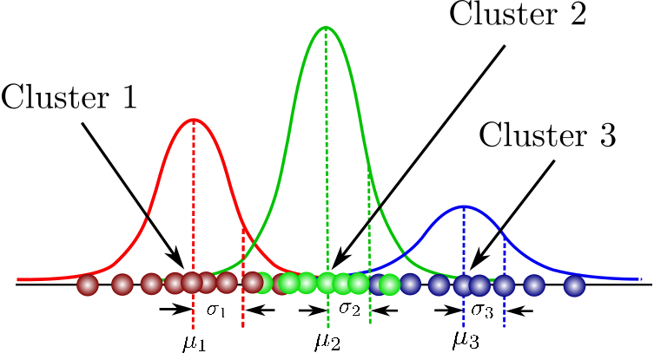
Gaussian mixture model
Easy enough to write down:
mixture coefficients π_{k}
means μ_{k}
standard deviations
or precision matrices Σ_{k}
p(x_{i}|θ) = Σπ_{k}Normal(x_{i}|μ_{k},Σ_{k})
After the sum, the class k is lost.

